Slide 1
Unidata Policy Committee
NOAA/NWS Update
May 23, 2011
LeRoy Spayd
Chief Training Division
Office of Climate, Water, and Weather Services
NOAA’s National Weather Service

Slide 2
Outline
NOAA Budget
NOAA Climate Service Status
NOAA Renewable Energy
MADIS Status
NWS Forum on Wireless Weather Services (June 28th)
NOAA Data Growth
AWIPS II
NEXGEN & 4D Cube

Slide 3
NOAA Budget – FY 11
$ 4.5 Billion budget (year long CR, not line item budget)
$ -1.0 Billion below President’s request
$ - 227 Million below FY 10
NOAA must submit a spend plan by June 15 to Congress
Spend plan to address not receiving $1.1Billion for Joint Polar Satellite System
Hall amendment – no funds may be used to implement, establish or create a NOAA Climate Service (limitation expires 09/30/11)
Note a proposal to establish a NOAA Climate Service was part of President’s FY 12 budget submission

Slide 4
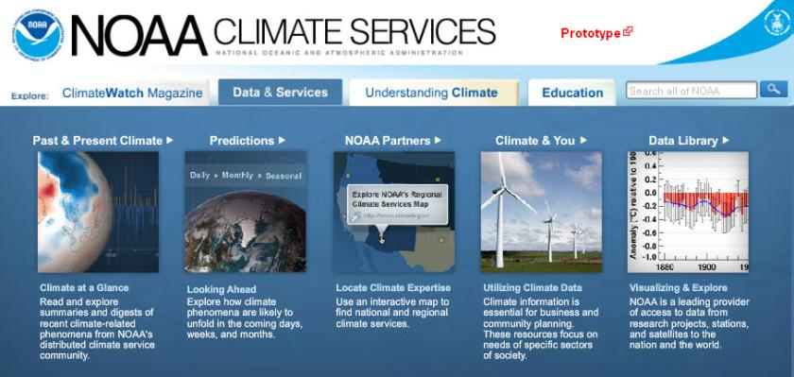
NOAA Climate Service
NCS Core Capability 1: Observing Systems, Data Stewardship, and Monitoring
NCS. users will obtain easy and timely access to the nation’s trusted data and information about the current state of the climate system in context with the past
Notes:
Purpose: Another key driver for NOAA is the formation of its Climate Service. Accurate information is clearly a foundation of this effort and one in which data documentation will be critically important.
NOTE: Metadata is required for inclusion of any dataset, report, or other product in the portal.

Slide 5
Renewable Energy
NOAA signed a MOU with Department of Energy (DOE) to spur collaborative work on weather-dependent and oceanic renewable energy.
DOE funding NOAA to perform the Wind Forecast Improvement Project (WFIP), a year long field campaign in northern Plains and west Texas starting this summer.
NOAA has $2M in the FY12 Presidential Budget to perform studies on improving wind characterization and forecasts in the planetary boundary layer in support of wind energy. Additional field tests are expected (both onshore and offshore) as well as in complex terrain .
NOAA and DOE issued a joint press release on a turbine wake study: https://www.llnl.gov/news/newsreleases/2011/Apr/NR-11-04-06.html

Slide 6
Renewable Energy…cont’d
NOAA is involved in Renewable Energy across the spectrum of our capabilities:
- Participating in the Offshore permitting process which includes environmental assessments and protection of native species and habitats
- Research into improving characterization and prediction of onshore/offshore winds, solar, and marine hydrokinetics (e.g., power from waves, currents, tides)
- Provision of numerical forecasts that serve as the basis for private sector customization for power generation and integration decision making.

Slide 7
MADIS Status
Initial Operating Capability (IOC) achieved by NWS in September, 2010.
IOC MADIS feed through NWS Telecommunications Operations Center (TOC) Gateway
Both NWS and GSD currently supporting MADIS feeds.
GSD running MADIS archives from 2001.
Complete transition of Full Operating Capability (FOC) to NWS in 2013-2015 (budget dependent)
FOC Archives in NCDC- seamless access

Slide 8
NWS Forum on Wireless Weather Services – June 28
Goals
Engage NWS, private sector, and core partners in discussions on how best to provide wireless environmental information services.
Solicit feedback on most appropriate role for NWS in providing wireless weather services.
Discussion Areas
How can the enterprise best serve the needs of NWS core partners?
How can the enterprise best serve the needs of general public?
What does the private sector need from NWS to support development of low cost wireless weather services?
Notes:
Definitions:
Enterprise=government and private sector
Core Partners = emergency management community + government partners + media

Slide 9
Current and Future NOAA Data Rates
 | Today’s Data Rates |  | Future Data Rates (projected) |  | Notes
 | Total Available | Total on AWIPS | Total Available | Total on AWIPS
Satellite | 86 Mbps | 1.5 Mbps | 741 Mbps 500 Mbps 500 Mbps | 4.5 Mbps 23 Mbps 21 Mbps | NPP/JPSS (2011) GOES-R (2015) GOES-S (2016)
Model | 68 Mbps | 6 Mbps | 612 Mbps | 40 Mbps | Up to 3x every 3 yrs
Radar | 3.9 Mbps (Lev 2) 2 Mbps (Lev 3) | 2 Mbps | 9 Mbps (Lev 2) 9 Mbps (Lev 3) | 3 Mbps | Dual Pol (2011)
Other (e.g. mesonets) | 0.4 Mbps | 0.3 Mbps | 0.5 Mbps | 0.4 Mbps | Non specific
Total | 160 Mbps | 10 Mbps | 2372 Mbps | 92 Mbps

Slide 10
Data Requirements Assumptions
Data Available to AWIPS, NCEP, and the Gateway
Dual-Pol
GOES-R
GOES-S
NPP
* Note: Volume of other products (e.g. METARS) is negligible
10
Notes:
Observing Systems and Models are driving bandwidth growth
Exponential growth over the next decade
IT Infrastructure Plan Supports Enabling the forecaster for Day 1 products
Cannot build anything more due to limitations
Planning vision
Cannot afford anything else in this fiscal environment

Slide 11
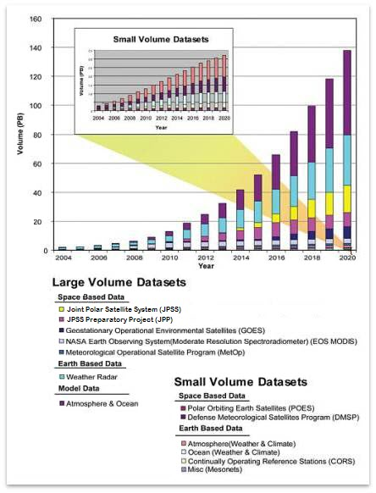
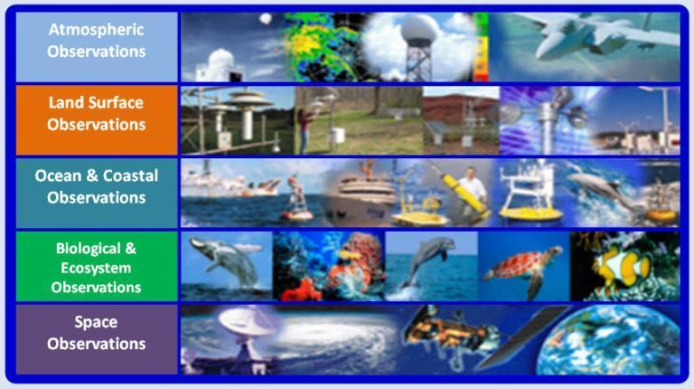
Environmental Information Mgmt.
Challenges
Broad Scope for Environmental Data Stewardship
~150 Research & Operational Observing Systems
~4-5 Petabytes of data/year (~15 Pb total)
Data Management Challenges are Changing
No longer just about data volume
Data discovery and integration
Data stewardship and information
Prepared by Environmental Data Management Committee for NOAA Leadership
Notes:
Purpose: The purpose of this slide is to highlight some of the environmental information management challenges facing NOAA.
NOAA covers a broad scope of environmental observing and data stewardship of any federal agency
NOAA maintains and makes use of the information from over 150 different observing systems and collects 4-5 Pb/year of environmental observations from state variables to chemical constituents to fish populations
Managing these data is a challenge:
But the challenge is no longer the volume of data as once feared
Making data available in formats that are useful to users both inside and external to NOAA
11

Slide 12
WFO AWIPS Status
Last 2 major software releases, all “bug” fixes, and local applications migration scheduled to be completed by June 30 (both behind schedule)
Field OT& E (WFO’s using AWIPS II operationally) to begin in July
(behind schedule due to ongoing “software bugs”, slower than expected local application migration, and workstation stability and performance – which has limited testing of full WFO functionality and backup operations)
Goal is to make 1 WFO “deployed” by end of FY 11 – Full deployment phased in during FY 12

Slide 13
DR Progress Tracking
Open Planned v.s. Actual (05/02/11)
# of Open DR’s
System OT&E
Test Periods
FIT Tests
Actuals as of (05/02/11)
29% rework rate (13 failed DR’s out of 45 tested)
10% wk. ending 04/22, 19% wk. ending 04/15
9 New DR’s last week Avg. 18/wk, last 3 wks
28 DRs wk ending 04/22, 16 DRs wk. ending 04/15
19 net DR increase, (v.s. 44 planned decrease)
3 wk. rolling avg. = xx net decrease per week
2.23 DR’s per person per week, for current wk.
1.41 wk. ending 04/22, 1.72 wk. ending 04/15
Raytheon staff: 39 (unchanged from 6/28/10)
87 DR’s fixed last week. Avg. 70/wk, last 3 wks.
55 wk. ending 04/22, 67 wk. ending 04/15
13

Slide 14
AWIPS Technology Infusion Local Application Migration
 | Open |  |  | Cancel (i.e. Dup, OBE) | Complete
 | Total | In Progress | Test
January 28, 2011 | 549 | 0 | 0 | 44 | 13
April 29, 2011 | 365 | 50 | 25 | 56 | 185
Net Change | - 184 |  |  | +12 | +172

Slide 15
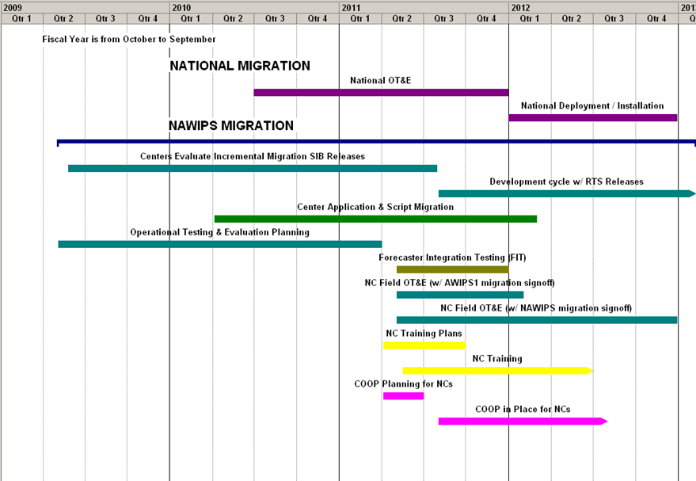
Current Full AWIPS II Migration Schedule
You are here
5/13/2011
15
Notes:
15

Slide 16
NEXGEN & 4D Cube Issues
Role of Forecasters “over the loop” given 5-15 minutes refresh rates?
How to determine the Single Authoritative Source?
Intended to be Open Source Project
How will interface to external world be managed to other gov, private sector and academia?
What role will Unidata have?
How will AWIPS2 evolve into the 4D cube?
Technical implementation schedules are budget dependent

